Slide 1
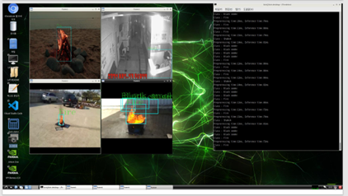
Fire and Smoke Detection at AI edgy box : ADK-JN-FIRE
Our AI model, which possesses 1.7 million fire and smoke image data, was trained on a selected 200,000 images. It classifies into 11 different categories, including false positives due to scenes like fireworks and smoke. It demonstrates a high performance with an average precision (mAP) of 0.90019. Operating on a Jetson Nano, it achieves recognition speeds of 76-85ms per frame, which is 1/20th the performance of a standard AI PC. It boasts a flame detection rate of over 0.3% of the screen size and can detect as low as 0.1% for clean flames.
Additionally, it offers cross-platform compatibility, supporting Windows, Linux, and ARM architectures.
ITEM | Spec | Remarks
Processor | 128 Core NIVIDA Maxwell GPU Quad core ARM A57 CPU 4GB 64bit LPDDR4
Network | 10/100/1000Base-T Ethernet
Power | DC5V, 4A
I/O | USB 3.0 Type A, 4Ea USB2.0 micro–B, 4Ea HDMI/Display Port Gigabit Ethernet GPIO, I2C, SPI, UART
SD card | Micro SD
Video Encoder | 4K@30 | 4x1080P@30 | 9x720p@30(H.264/H.265)
Video Decoder | 4K@60 | 2x4K@30| 8x1080P30 | 18x720p@30(H.264/H.265)
AI Algorithm | Smoke & fire
IP Camera | RTSP
Class of Detection | Black smoke occurrence Gray smoke occurrence White smoke occurrence Fire(flame) occurrence Cloud Fog(smoke) Lighting Sunlight Wobbly white object Leaves, grass, etc, shaken by the wind Non(Irrelevant)
Recognition Speed | 76~85ms/frame(About 11~13FPS)
Fire frame detection | More than 0.3% of screen size(85x85pixels at 1920x1080 resolutions)
F1-Score | 0.861952
Dimension mm(Board) | TBD

